Slide 1
AZ-303: Microsoft Azure Architect Technologies

Slide 2






Module 12: Manage Workloads in Azure
Lesson 01: Migrate Workloads using Azure Migrate
Lesson 02: VMware Agentless Migration
Lesson 03: VMware Agent-Based Migration
Lesson 04: Implement Azure Backup
Lesson 05: Azure to Azure Site Recovery
Lab: Protecting Hyper-V VMs by using Azure Site Recovery

Slide 3
Lesson 01: Migrate Workloads using Azure Migrate

Slide 4
Azure Migrate Server Migration Overview
Overview of Azure Migrate Server Migration
VMware Migration
Deployment Steps Comparison
Hyper-V Migration
Agent-based Migration Architecture

Slide 5
Overview of Azure Migrate Server Migration
Assess
Migrate
Optimize
Secure & Manage
Helps you to migrate on-premises VMware VMs, Hyper-V VMs, physical servers, other virtualized machines, and private/public cloud instances to Azure

Slide 6
VMware Migration
There are two options Agentless replication and Agent-based replication
Agentless replication: No agent installation
Simultaneous replication – maximum of 300 VMs migrated at a time
VM must have less than 60 disks
VM operating systems may need manual changes before migration
Possible ssues with Linux/EUFI boot, encrypted disks/volumes, NFS volumes, and target storage
Agent based replication: Install an agent on the VM for replication.
Agentless replication is easier to deploy in VMware, but currently has some limitations

Slide 7
Deployment Steps Comparison
Details | Agentless | Agent-based
Configure several settings on VM servers and VMs | Required | Required
Add the Azure Migrate Server Migration tool in the Migrate project | Required | Required
Set up a lightweight appliance on a VMware VM for discover and assessment | Required | Not Required
Install the Mobility service on each VM you want to replicated | Not Required | Required
Set up an appliance on a VMware VM to discover VMs and bridge between the Mobility service running on VMs and Migrate Server Migration | Not Required | Required
Configure replication settings and select VMs to replicate | Required | Required
Run a test migration to make sure everything is working | Required | Required
Migrate the virtual machines | Required | Required

Slide 8
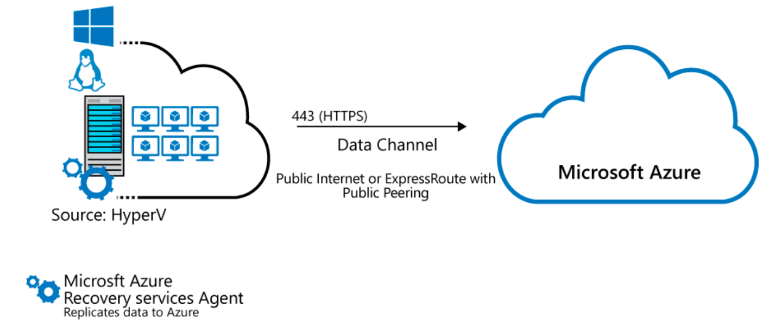
Hyper-V Migration
Agentless
Host Based

Slide 9
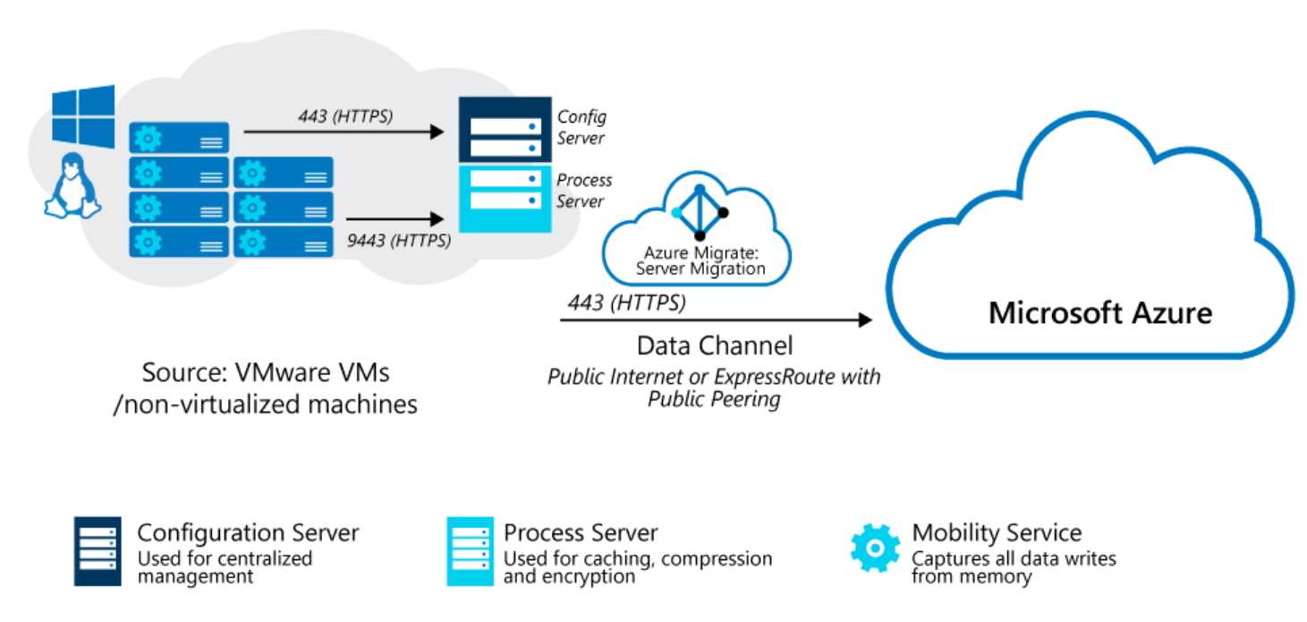
Agent-Based Migration Architecture
Configuration VM
ESXi hosts >v5.5
Permissions
VM Requirements
Mobility Service
Azure Storage
Notes:
VM Requirements - https://docs.microsoft.com/en-us/azure/site-recovery/vmware-physical-azure-support-matrix#replicated-machines
Azure Storage - https://docs.microsoft.com/en-us/azure/site-recovery/vmware-physical-azure-support-matrix#azure-storage

Slide 10
Instructor Notes
Slides 13 – 64 can be demonstrated directly from the Azure Portal
Next:

Slide 11
Lesson 02: VMware Agentless Migration

Slide 12
VMware Agentless Migration Overview
Prepare for Agentless VMware Migration
Add the Azure Migrate Server Migration Tool
Prepare VMs for Migration
Replicate VMs
Target, Compute, and Disk Settings
Tracking and Monitoring Replication
Provisioning For the First Time
Testing the Migration
Migrating Virtual Machines
Notes:
This student topic does not have a slide: Agentless migration-appliance requirements.

Slide 13
Prepare for Agentless VMware Migration
Review VMware server requirements for agentless migration.
Set up an account to access the vCenter Server with the required permissions for agentless migration.
Note the requirements for VMware VMs that you want to migrate to Azure using agentless migration.
Review appliance requirements for agentless migration.
Note appliance URL access and port access requirements for agentless migration.

Slide 14
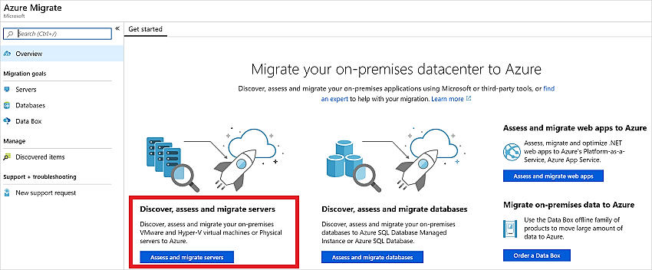
Add the Azure Migrate Server Migration Tool (1 of 3)
In the Azure Migrate project, click Overview.
In Discover, assess, and migration servers, click Assess and migrate servers.

Slide 15
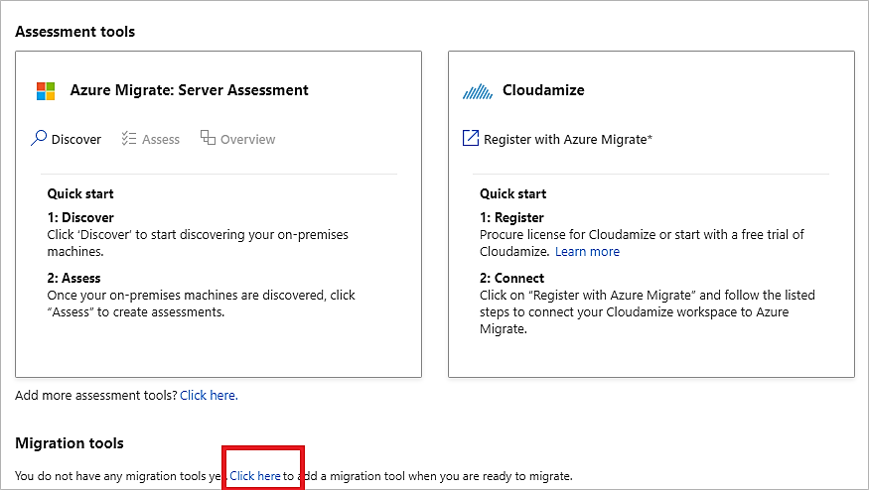
Add the Azure Migrate Server Migration Tool (2 of 3)
In Migration tools, select Click here to add a migration tool when you are ready to migrate

Slide 16
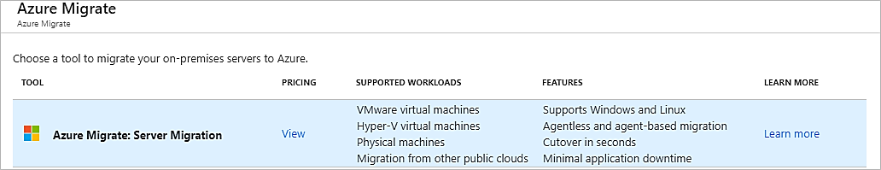
Add the Azure Migrate Server Migration Tool (3 of 3)
In the tools list, select Azure Migrate: Server Migration > Add tool

Slide 17
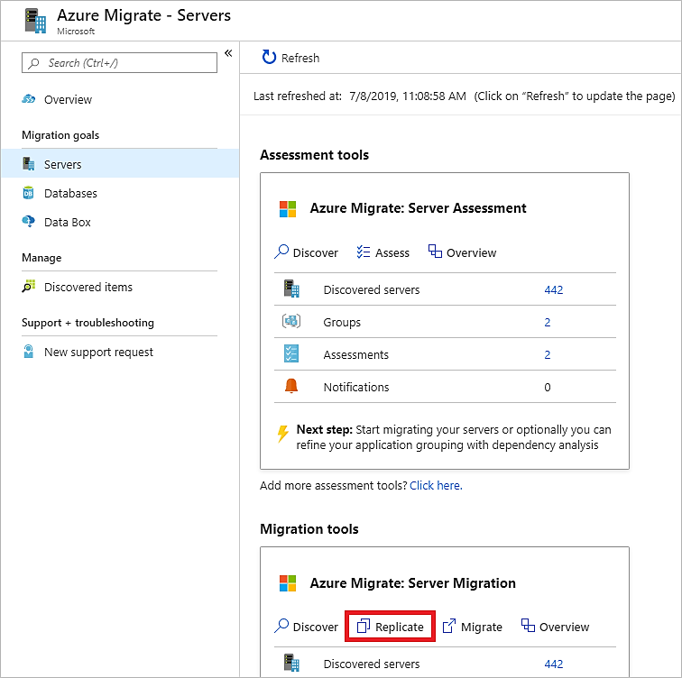
Replicate VMs (1 of 4 )
In the Azure Migrate project > Servers, Azure Migrate: Server Migration, click Replicate

Slide 18
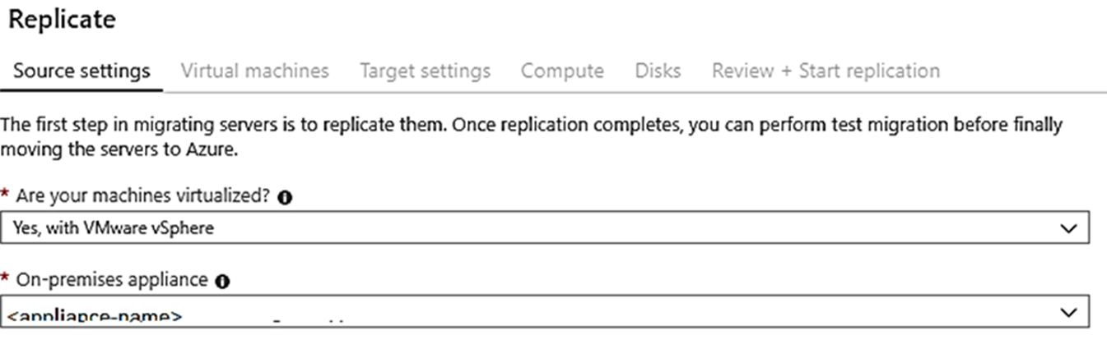
Replicate VMs (2 of 4)
In Replicate, > Source settings > Are your machines virtualized?, select Yes, with VMware vSphere.
In On-premises appliance, select the name of the Azure Migrate appliance that you set up > OK.

Slide 19
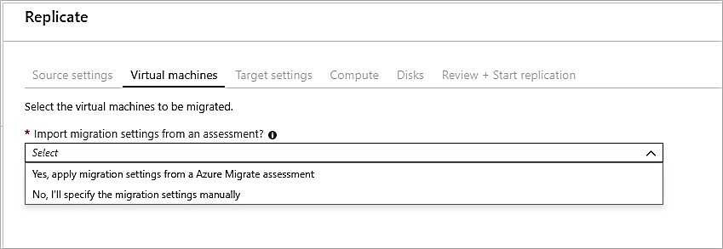
Replicate VMs (3 of 4)
In Virtual machines, select the machines you want to replicate.

Slide 20
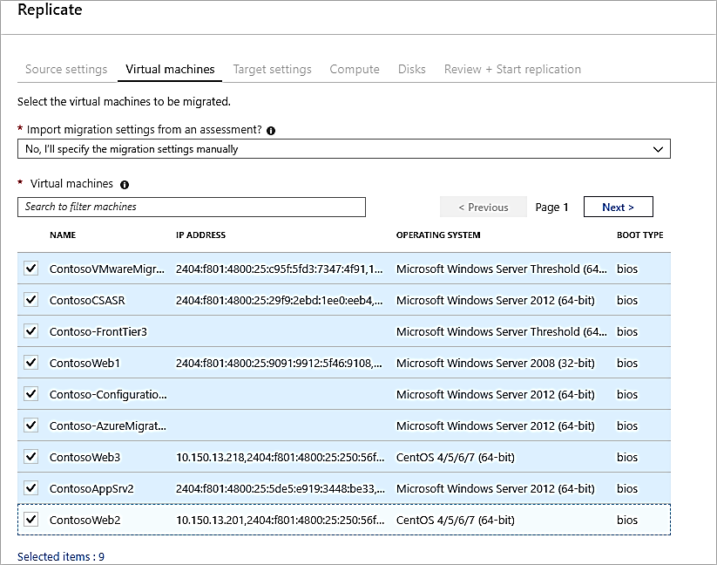
Replicate VMs (4 of 4)
In Virtual machines, search for VMs as needed, and check each VM you want to migrate.
Then click Next: Target settings.

Slide 21
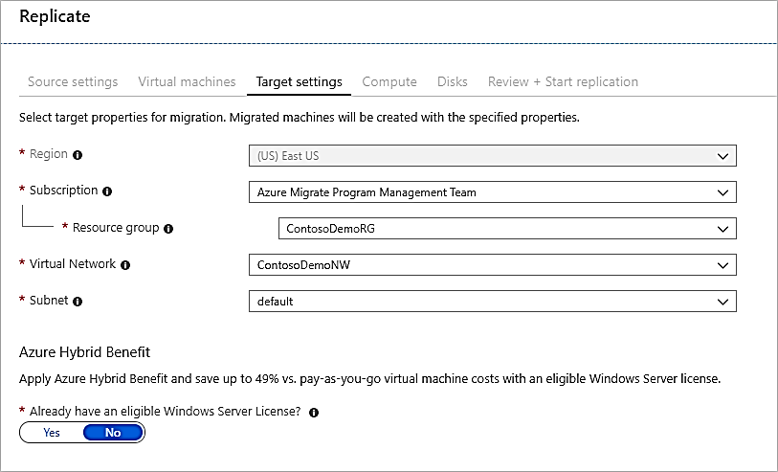
Target Settings (1 of 3)

Slide 22
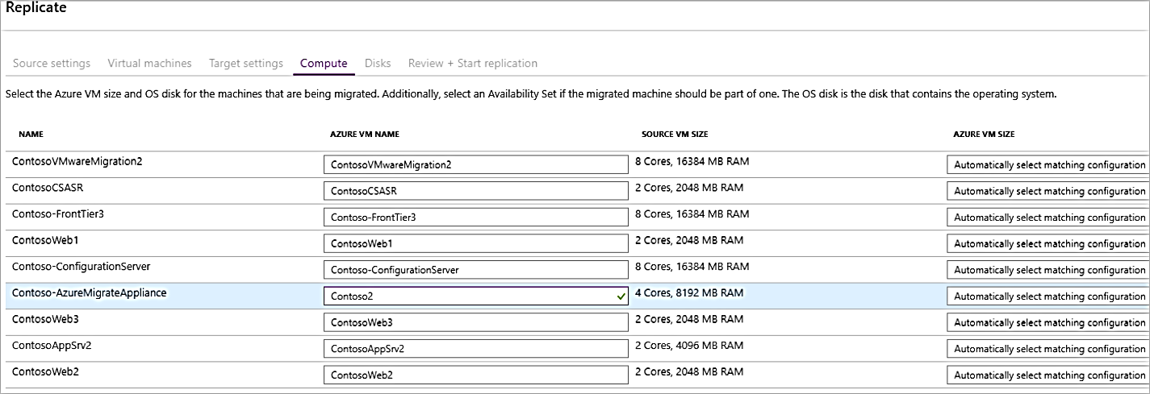
Compute Settings (2 of 3)

Slide 23
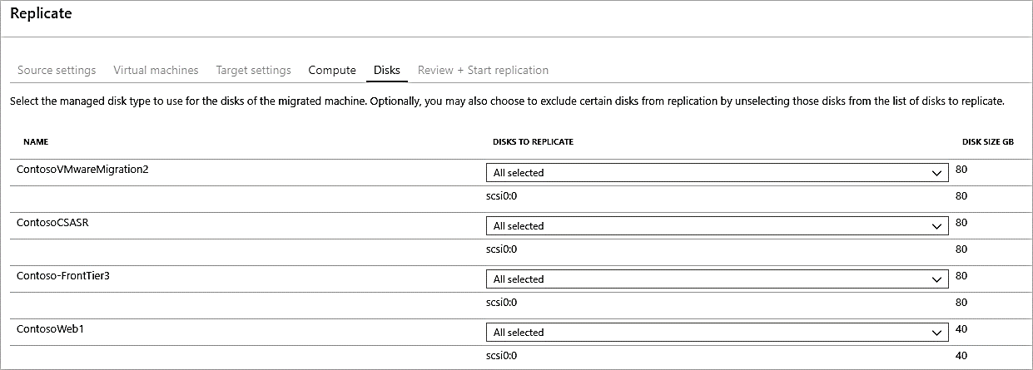
Disk Settings (3 of 3)

Slide 24
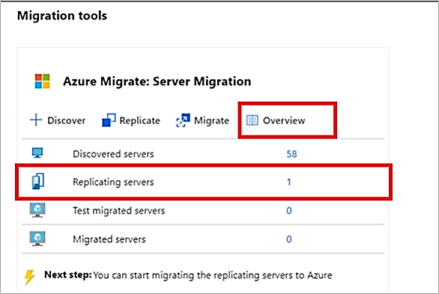
Tracking and Monitoring Replication (1 of 2)
You can monitor replication status by clicking on Replicating servers in Azure Migrate: Server Migration

Slide 25
Tracking and Monitoring Replication – 1st time provisioning (2 of 2)
If this is the first VM you're replicating in the Azure Migrate project, Azure Migrate Server Migration automatically provisions these resources in same resource group as the project.
Service bus
Gateway storage account
Log storage account
Key vault

Slide 26
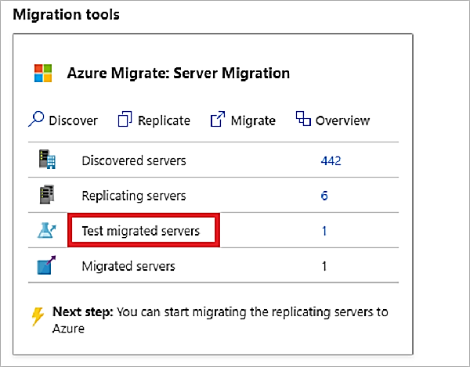
Test Migration (1 of 3)
In Migration goals > Servers > Azure Migrate: Server Migration, click Test migrated servers.

Slide 27
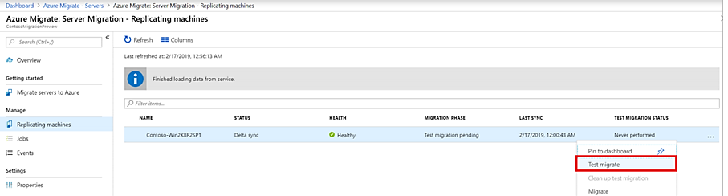
Test Migration (2 of 3)
Right-click the VM to test, and click Test migrate

Slide 28
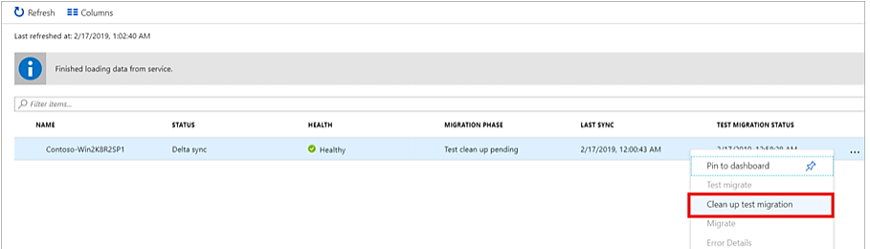
Test Migration (3 of 3)
After the test is done, right-click the Azure VM in Replicating machines, and click Clean up test migration

Slide 29
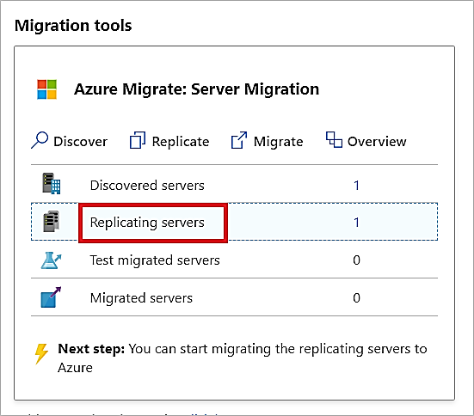
Migrate Virtual Machines
After you've verified that the test migration works as expected, you can migrate the on-premises machines.
In the Azure Migrate project > Servers > Azure Migrate: Server Migration, click Replicating servers
In Replicating machines, right-click the VM >Migrate

Slide 30
Lesson 03: VMware Agent-Based Migration

Slide 31
VMware Agent-Based Migration Overview
Prepare Azure for Migration
Prepare the On-premises VMware Environment
Add the Azure Migrate Server Migration Tool
Replication Appliance
Appliance Setup and Registration
Replicate VMs
Replication - Selecting the VMs to Replicate
Track and Monitor the Replication
Test the Migration

Slide 32
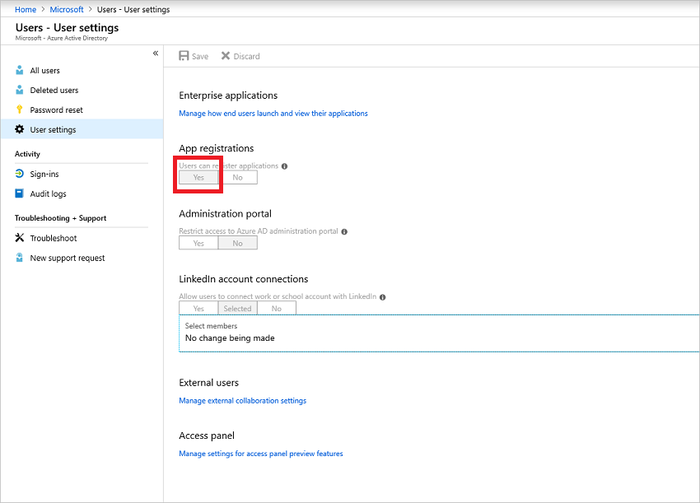
Prepare Azure for Migration
Create an Azure Migrate project
Register the Azure Migrate replication appliance
Create Key Vault
Grant account permissions

Slide 33
Prepare the On-premises VMware Environment
Azure Migrate Server Migration needs access to VMware servers on the VMware hosts.
Account access to:
Discover virtual machines – read-only account
Orchestrate replication, failover, and failback
Mobility service must be installed on machines you want to replicate
A domain or local account with permissions to install on the VM
For Linux VMs, prepare a root account on the source Linux server

Slide 34
Add the Azure Migrate Server Migration Tool (1 of 2)
In the Azure Migrate project, click Overview.
In Discover, assess, and migration servers, click Assess and migrate servers.

Slide 35
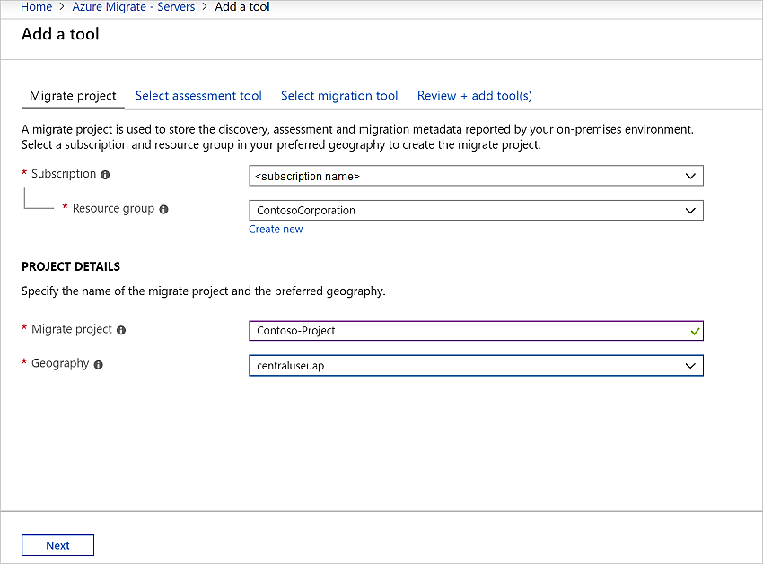
Add the Azure Migrate Server Migration Tool (2 of 2)
In Discover, assess and migrate servers, click Add tools

Slide 36
Replication Appliance
A single, highly available, on-premises VMware virtual machine
Hosts these components:
Configuration server: The configuration server coordinates communications between on-premises and Azure and manages data replication.
Process server: The process server acts as a replication gateway. It receives replication data; optimizes it with caching, compression, and encryption, and sends it to a cache storage account in Azure. The Process server also installs the Mobility Service agent on VMs you want to replicate and performs automatic discovery of on-premises VMware VMs.

Slide 37
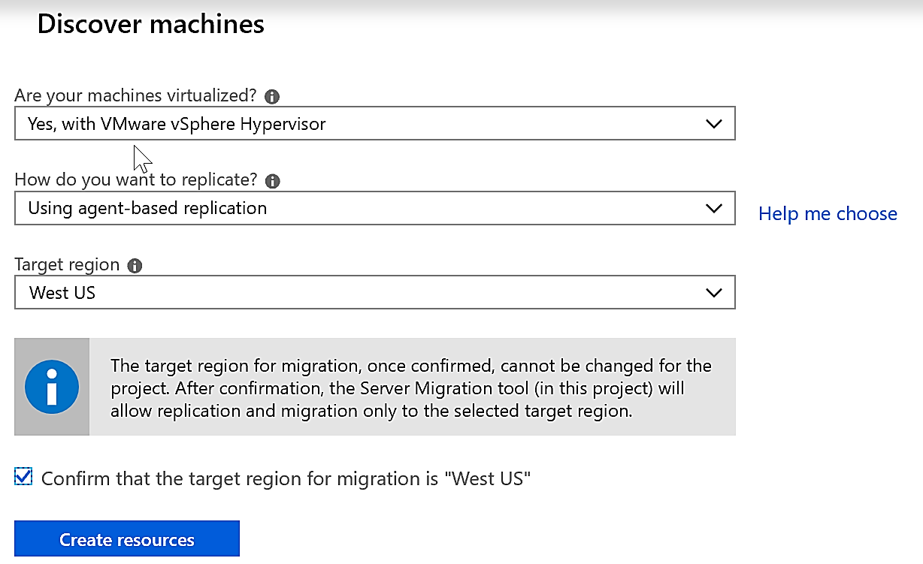
Appliance Setup and Registration (1 of 3)
Download the appliance template:
In the Azure Migrate project click Servers under Migration Goals
In Azure Migrate - Servers > Azure Migrate: Server Migration, click Discover

Slide 38
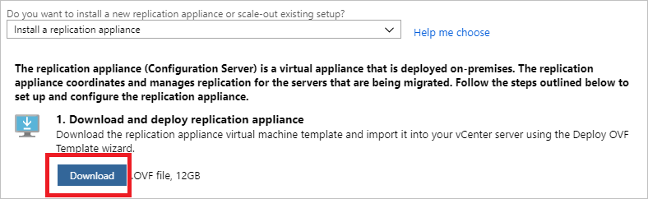
Appliance Setup and Registration (2 of 3)
In Do you want to install a new replication appliance?, select Install a replication appliance.
Click Download. This downloads an OVF template that you use to create a new VMware VM that runs the appliance.
Notice the name of the resource group and the Recovery Services vault. You need these during appliance deployment.

Slide 39
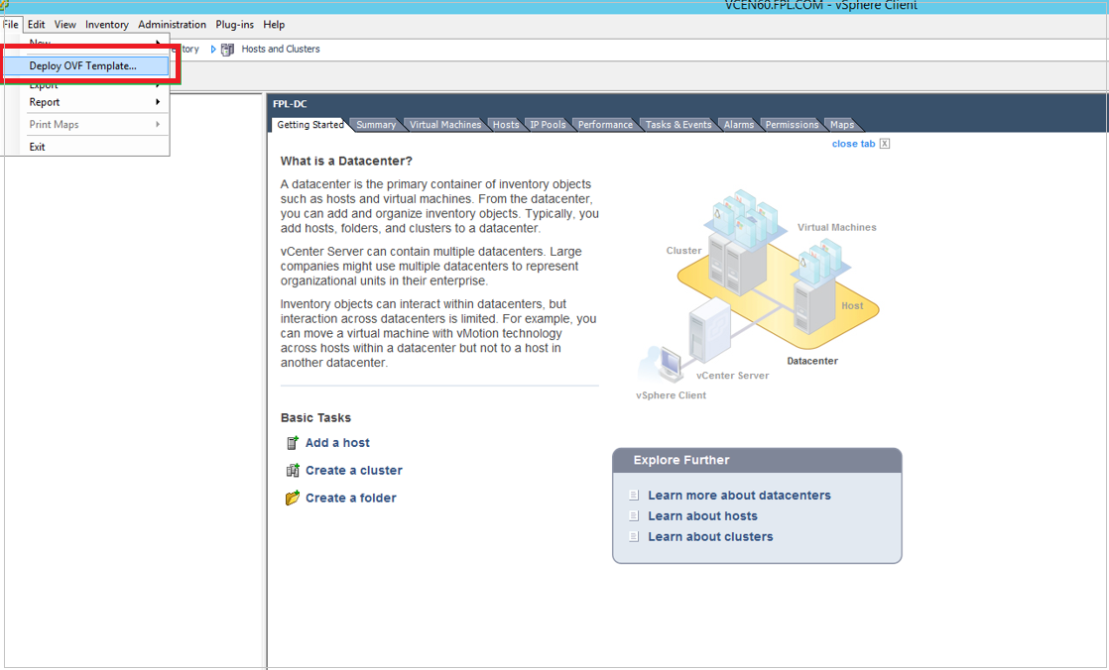
Appliance Setup and Registration (3 of 3)
After downloading the OVF template, import it into VMware to create the replication application on a VMware VM running Windows Server 2016

Slide 40
Replicate VMs (1 of 2)
In the Azure Migrate project > Servers, Azure Migrate: Server Migration, click Replicate

Slide 41
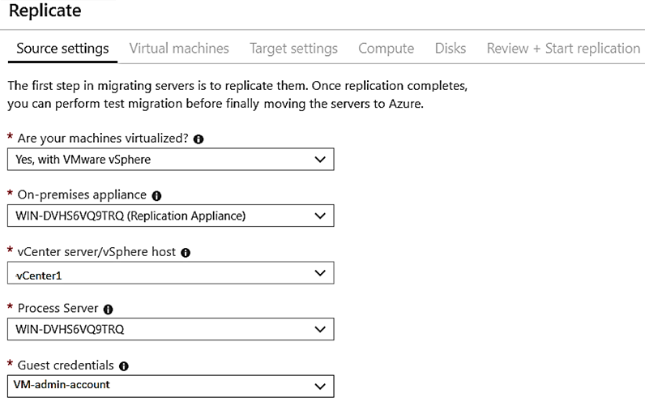
Replicate VMs (2 of 2)
In Replicate, > Source settings > Are your machines virtualized?, select Yes, with VMware vSphere

Slide 42
Replication - Selecting the VMs to Replicate (1 of 2)
In Virtual machines, select the machines you want to replicate.

Slide 43
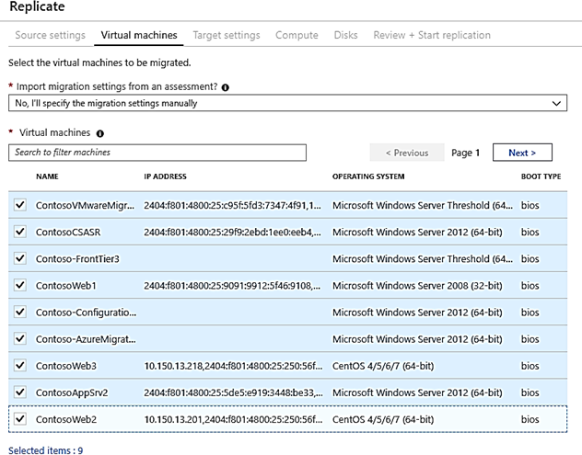
Replication - Selecting the VMs to Replicate (2 of 2)
In Virtual machines, search for VMs as needed, and check each VM you want to migrate.
Then click Next: Target settings.

Slide 44
Replication - Target, Compute, and Disk Settings (1 of 3)

Slide 45
Replication - Target, Compute, and Disk Settings (2 of 3)

Slide 46
Replication - Target, Compute, and Disk Settings (3 of 3)

Slide 47
Track and Monitor Replication
You can monitor replication status by clicking on Replicating servers in Azure Migrate: Server Migration

Slide 48
Test Migration (1 of 3)
In Migration goals > Servers > Azure Migrate: Server Migration, click Test migrated servers.

Slide 49
Test Migration (2 of 3)
Right-click the VM to test, and click Test migrate

Slide 50
Test Migration (3 of 3)
After the test is done, right-click the Azure VM in Replicating machines, and click Clean up test migration

Slide 51
Lesson 04: Implement Azure Backup

Slide 52
Implement Azure Backup Overview
Azure VM Backup Architecture
Microsoft Azure Backup Overview
Azure Backup Key Features
Azure IaaS Backup Components
Recovery Services Vault Overview

Slide 53
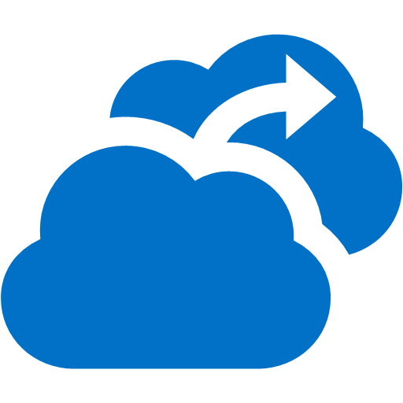

Azure VM Backup Architecture
1
Configure
Azure Backup Service
2
Backup
Policy Management
Azure Key Vault
KEK
Up to 4 TB per Disk
Recovery Services Vault
3
BEK
Up to 1,000 Azure VMs
VSS Snapshot
Instant Recovery Snapshot
Incremental
Blocks
4
HTTPS
SSE
Managed Disks

Slide 54
Microsoft Azure Backup Overview
Simple and reliable server backup to the cloud

Slide 55
Azure Backup Key Features (1 of 2)
Simple configuration and management
Simple, and familiar user interface to configure and monitor backups from Windows Server and System Center Data Protection Manager
Integrated recovery experience to transparently recover files and folders from the cloud
Windows PowerShell command-line interface scripting capability
Block level incremental backups
Automatic incremental backups track file and block level changes, only transferring the changed blocks, hence reducing the storage and bandwidth utilization
Different point-in-time versions of the backups use storage efficiently by only storing the changed blocks between these versions

Slide 56
Azure Backup Key Features (2 of 2)
Data integrity verified in the cloud
Backed up data is also automatically checked for integrity once the backup is complete. As a result, any corruptions due to data transfer are automatically identified and repair is attempted in the next backup
Configurable retention policies
Retention policies are used to control how long a backup will be saved in Azure. This helps to meet business policies and manage backup costs

Slide 57
Azure IaaS Backup Components (1 of 2)
Component | Benefits | Limits | Protected? | Stored?
Azure Backup Server (can be deployed in Azure and on-premises) | App aware snapshots (VSS) Full flexibility for when to take backups Recovery granularity (all) Can use Recovery Services vault Linux support on Hyper-V and VMware VMs Back up and restore VMware VMs Does not require a System Center license | Cannot back up Oracle workload. Always requires live Azure subscription No support for tape backup | Files Folders Volumes VMs Applications, Workloads System State | Recovery Services vault Locally attached disk

Slide 58
Azure IaaS Backup Components (2 of 2)
Component | Benefits | Limits | Protected? | Stored
Azure IaaS VM Backup | Native backups for Windows/Linux No specific agent installation required Fabric-level backup with no backup infrastructure needed | Back up VMs once-a-day Restore VMs only at disk level Cannot back up on-premises | VMs All disks (using PowerShell) | Recovery Services vault

Slide 59
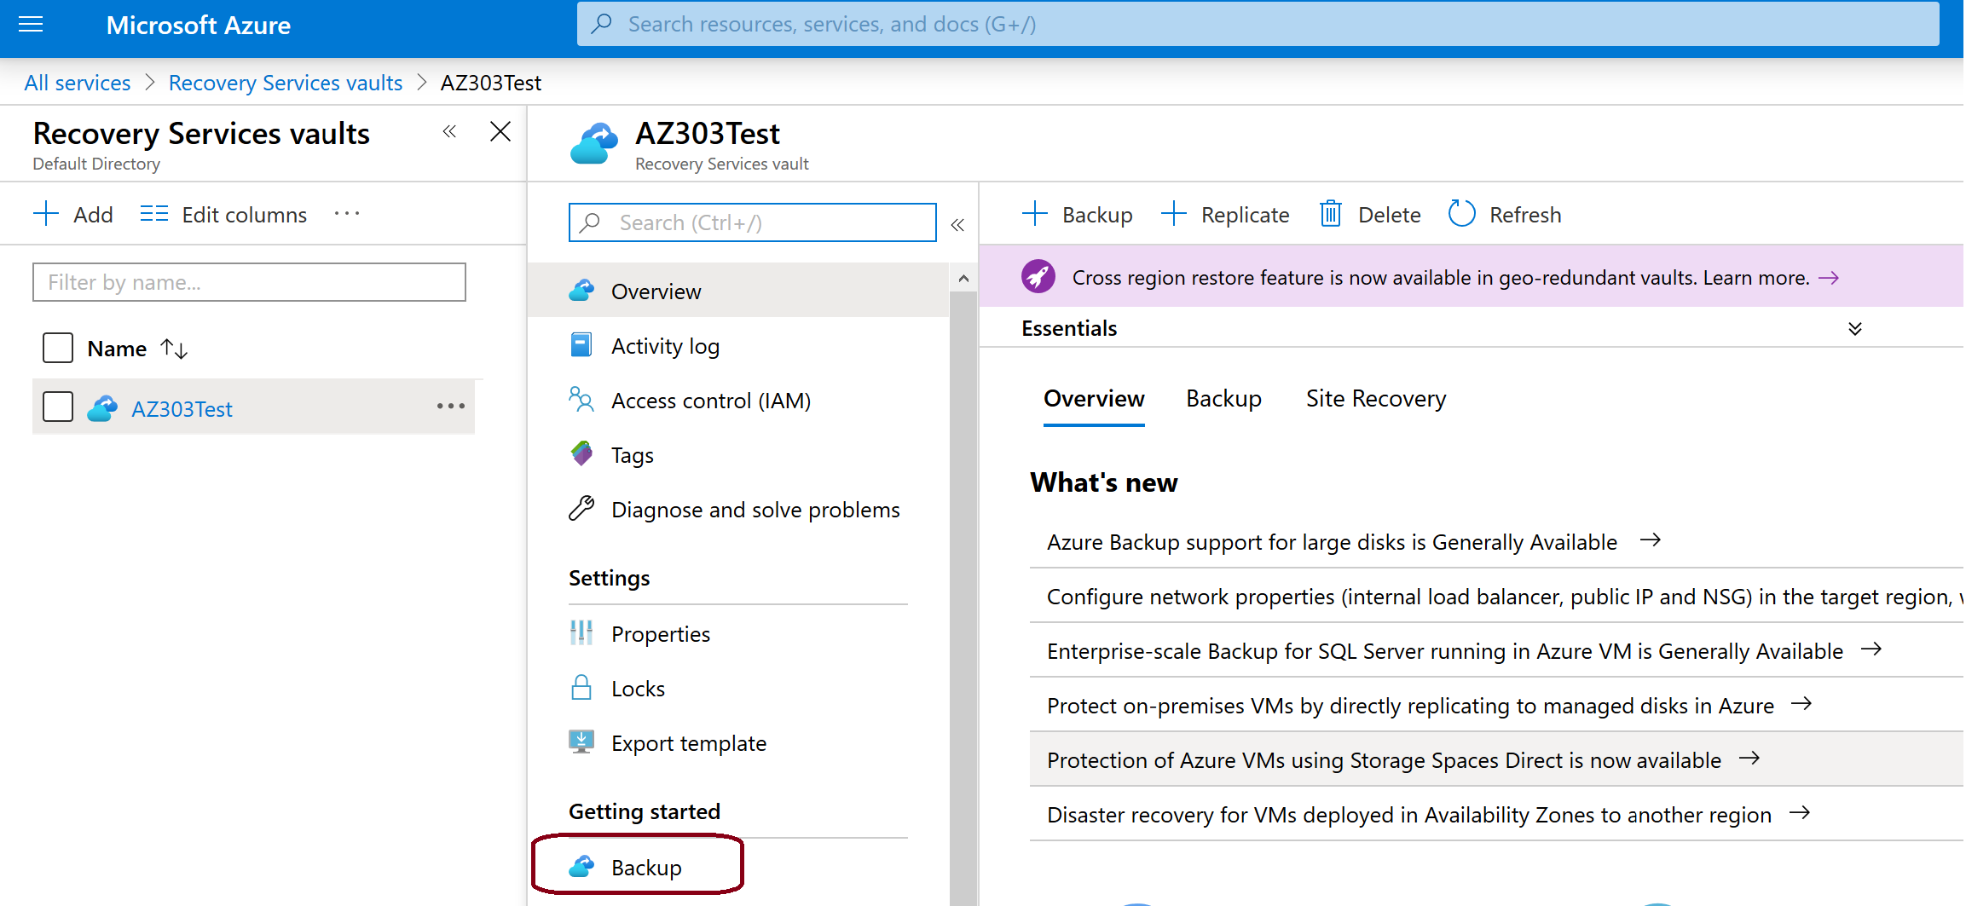
Recovery Services Vault Overview
A storage entity in Azure that houses data, like backups
Central monitoring for your hybrid IT environment
Provides Role-Based Access Control
Protects all virtual machine configurations
Instant restore for files and folders on the virtual machine

Slide 60
Lesson 05: Azure to Azure Site Recovery

Slide 61
Azure Site Recovery Overview
Azure to Azure Site Recovery
Azure to Azure Architecture
Azure to Azure Site Recovery – Network Traffic
Azure to Azure VM Protection
Configuration
Replication
Enable Replication
Settings
Customize Target Resources
Replication Settings
Test Failover
Recovery Plans

Slide 62
Azure to Azure Site Recovery
Replicate Azure VMs to any other Azure location
No infrastructure to deploy
Automatically deploys ASR Mobility Service extension to protected machines
Replicates virtual machines, virtual networks, availability sets, and storage accounts
Replicates on HTTPS channel on 443
Generates Azure egress cost for outbound traffic from primary region
Optionally – you can specify your own VNets, Storage Accounts and Availability Sets

Slide 63
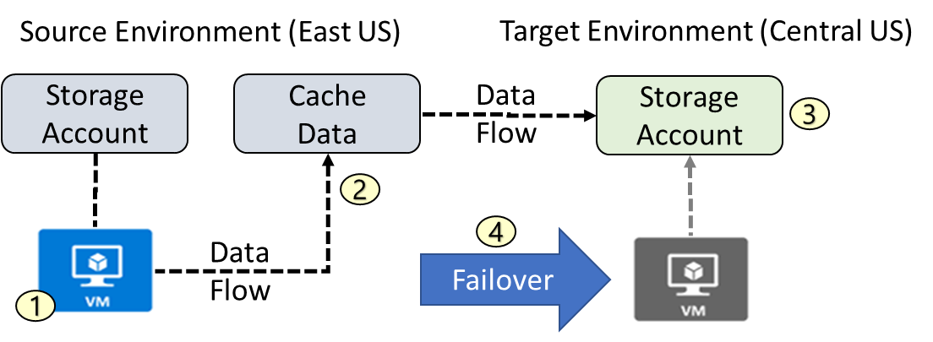
Azure to Azure Architecture
VM is registered with Azure Site Recovery
Data is continuously replicated to cache
Cache is replicated to the target storage account
During failover the virtual machine is added to the target environment

Slide 64
Azure to Azure Site Recovery: Network Traffic
ASR traffic is only outbound from protected VMs.
Outbound security rules for NSGs - Site Recovery service and monitoring IP addresses (location specific)
URL | Purpose
*.blob.core.windows.net | For storage account writes
login.microsoftonline.com | Authorization and authentication to the ASR URLs
*.hypervrecoverymanager.windowsazure.com | ASR service communication channel
*.servicebus.wifondows.net | monitoring and diagnostics
Location | Site Recovery service IPs | Site Recovery monitoring IP
Central US | 40.69.144.231 | 52.165.34.144
Notes:
https://docs.microsoft.com/en-us/azure/site-recovery/site-recovery-azure-to-azure-networking-guidance#sample-nsg-configuration

Slide 65
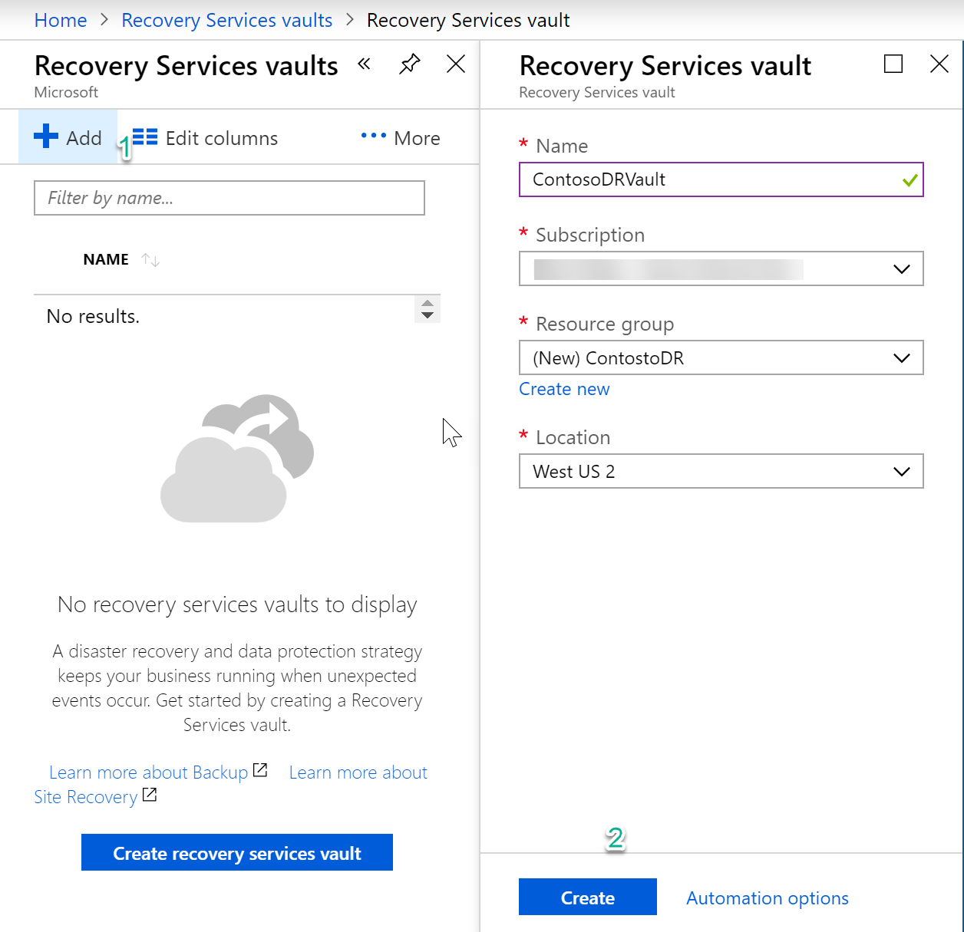
Azure to Azure VM Protection
Establish a recovery services vault in a different location than where your VMs reside

Slide 66
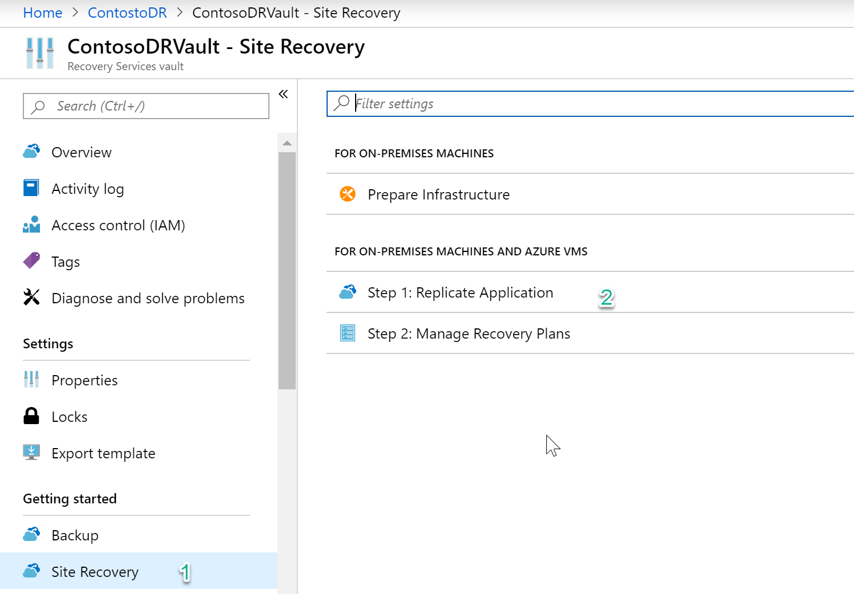
Configuration
Getting Started – Site Recovery
No infrastructure to prepare
Step 1: Replicate Application

Slide 67
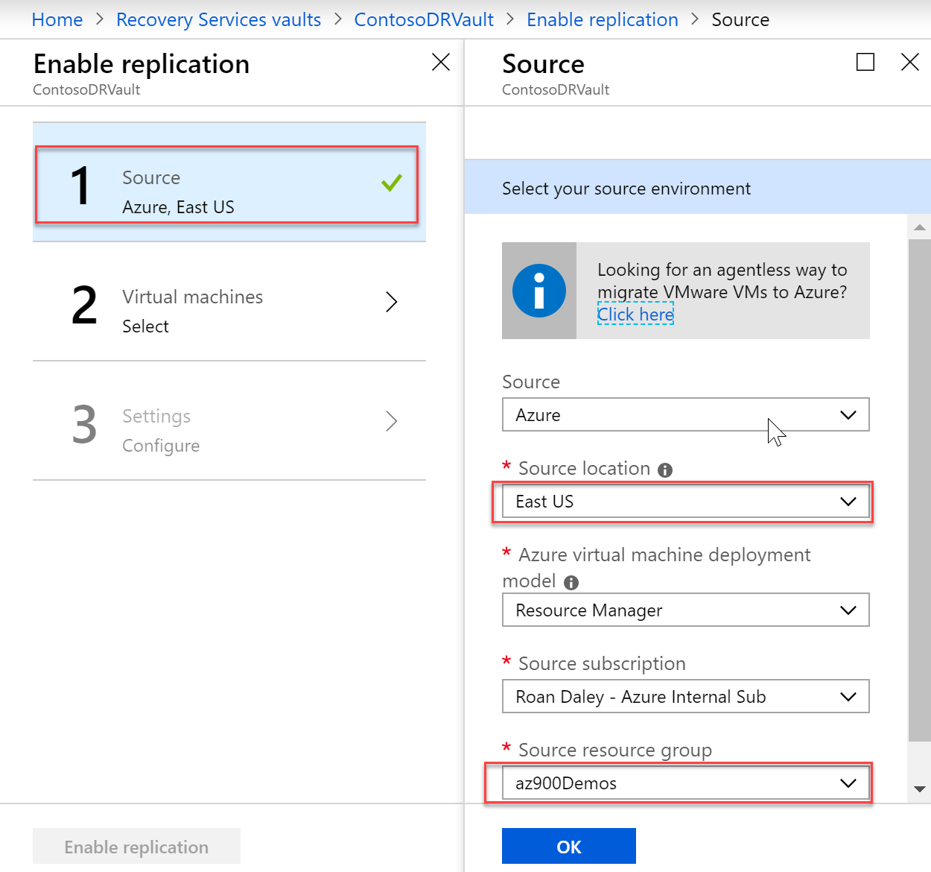
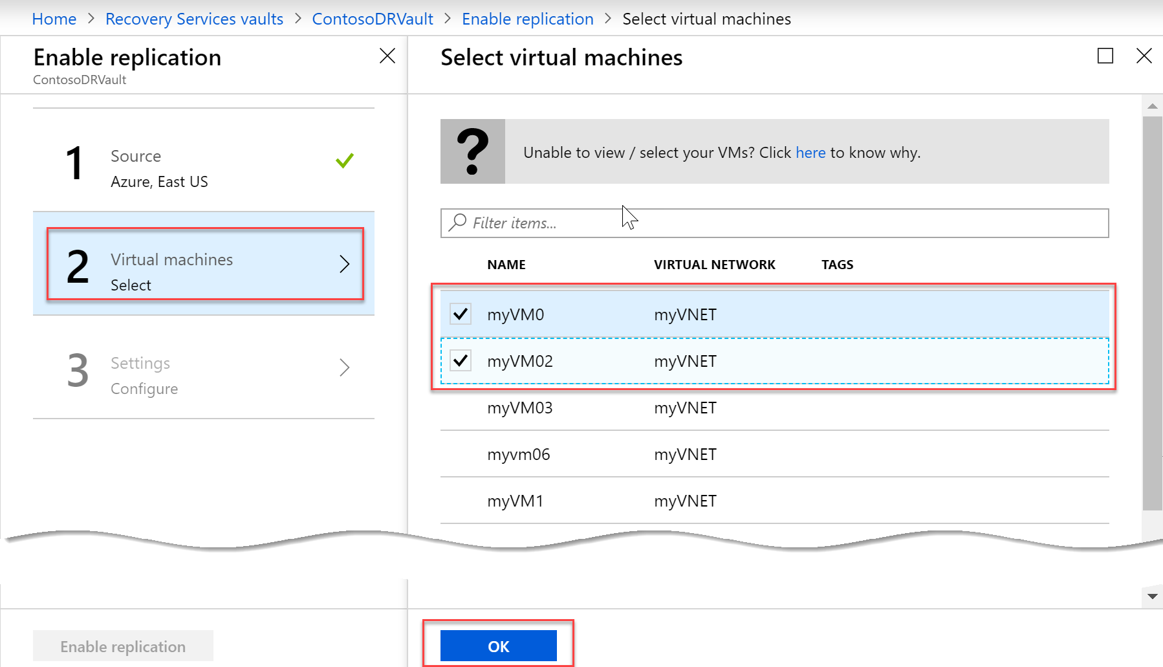
Enable Replication

Slide 68
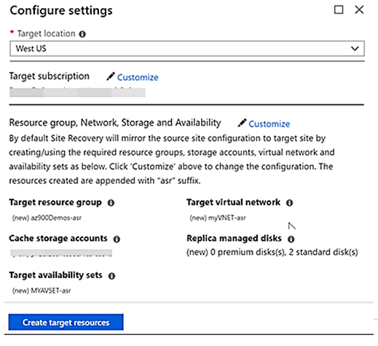
Settings
Target location (same as vault)
System (can) replicate VM
Resource Group Name
Virtual Network
Availability Sets

Slide 69
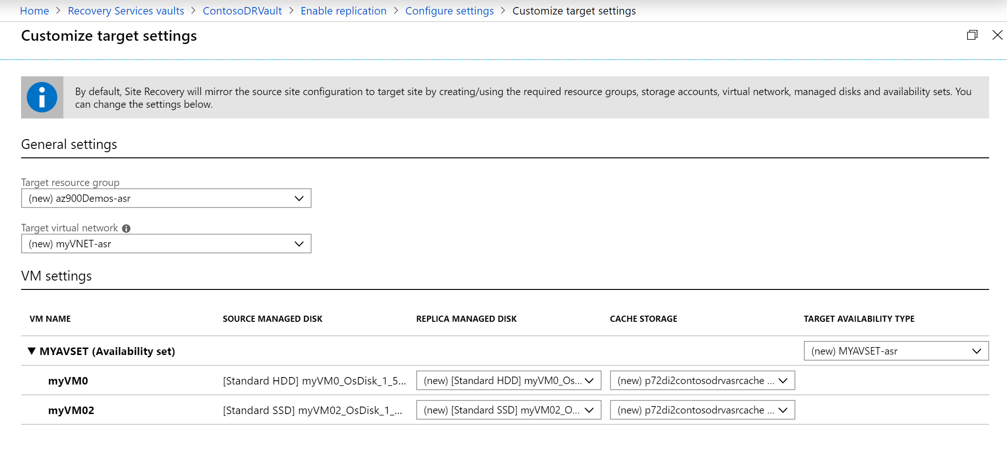
Customize target resources

Slide 70
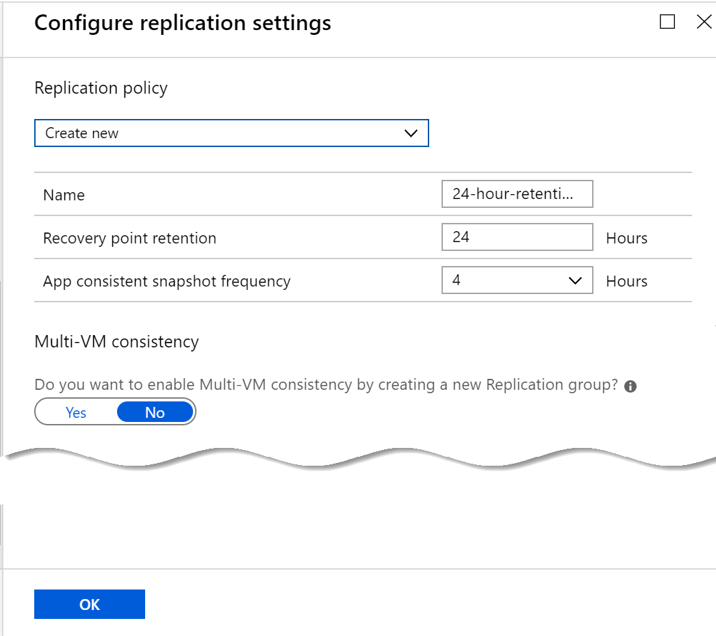
Replication Settings
Recovery Point Retention
App Consistency
Multi VM Consistency

Slide 71
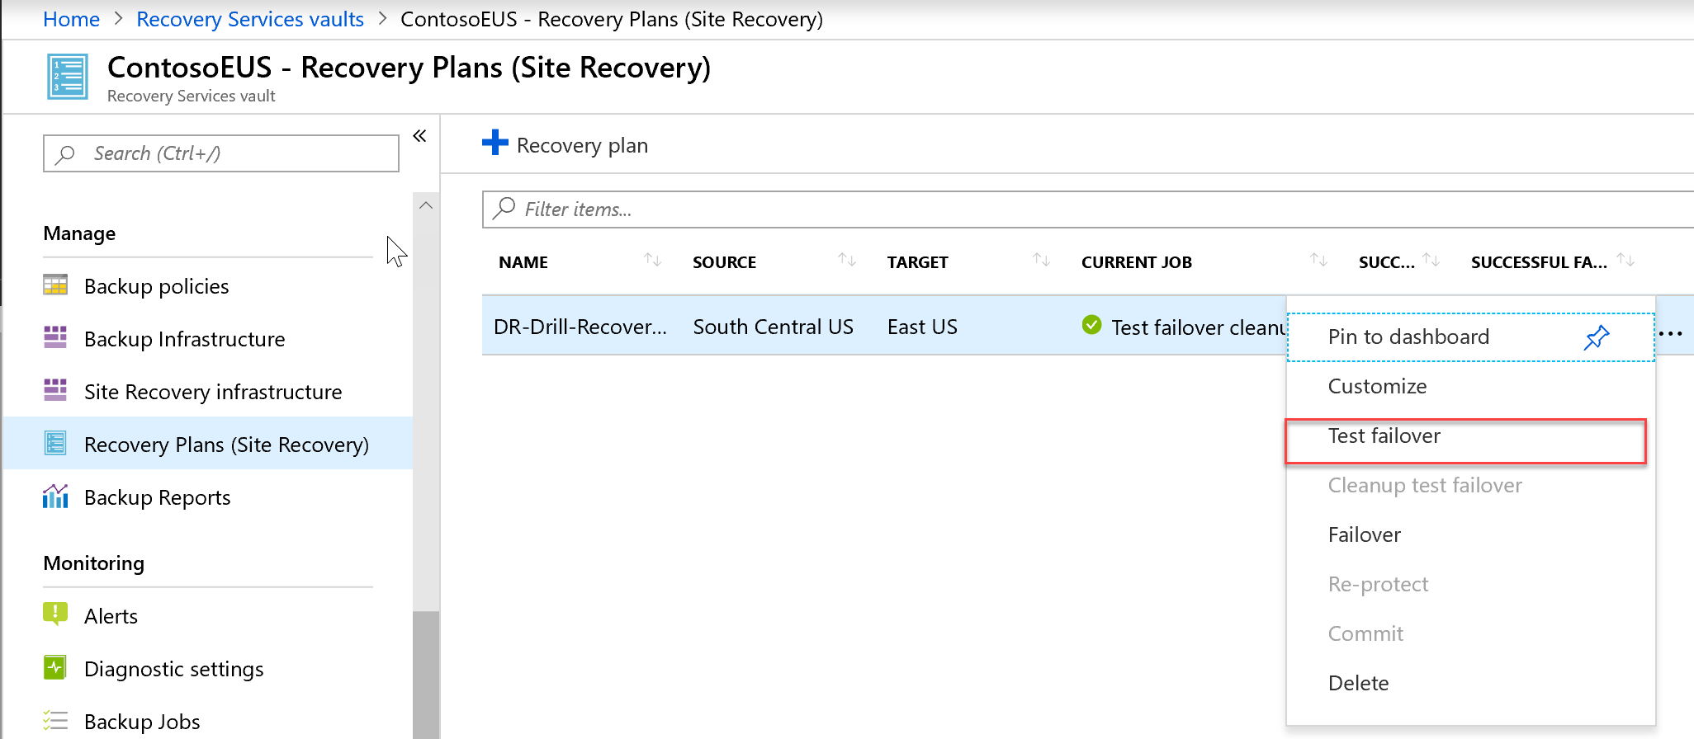
Test Failover

Slide 72
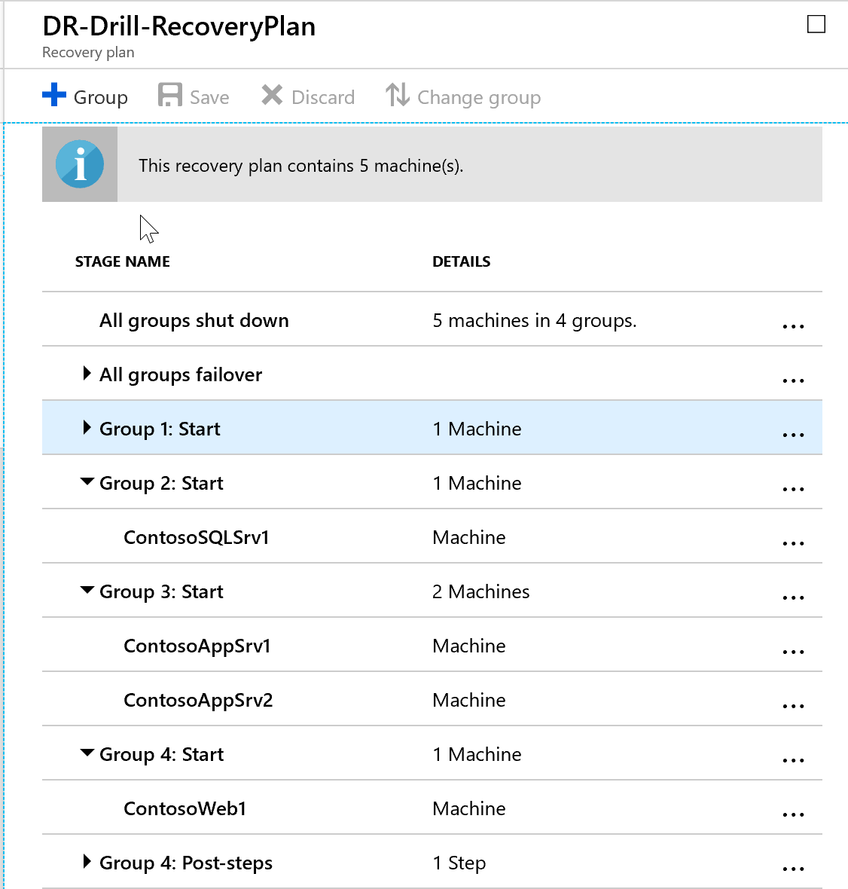
Recovery Plans
Model an app around its dependencies.
Automate recovery tasks to reduce RTO.
Verify that you're prepared for migration or disaster recovery by ensuring that your apps are part of a recovery plan.
Run test failover on recovery plans, to ensure disaster recovery or migration is working as expected.

Slide 73
Lab 12: Protecting Hyper-V VMs by using Azure Site Recovery
Configure Azure Site Recovery
Perform test failover
Perform planned failover
Perform unplanned failover

Slide 74
Implement Virtual Networking- Review
Knowledge Check
Microsoft Learn Modules (docs.microsoft.com/Learn)
Protect your Azure infrastructure with Azure Site Recovery
Architect migration, business continuity, and disaster recovery in Azure
Protect your virtual machines by using Azure Backup
Prepare to migrate VMware workloads to Azure by deploying Azure VMware Solution
Set up Azure Migrate for server migration
Notes:
Learn - https://docs.microsoft.com/en-us/learn/browse/

Slide 75
End of presentation

